Slide 1
How loss of PEPFAR support for outreach puts the 90-90-90 targets at risk: Results from a mixed methods evaluation in Kenya and Uganda
M. Qiu¹, L. Paina¹, D. Rodriguez¹, J. Wilhelm¹, C. Mackenzie², F. Ssengooba³, E. Eze-Ajoku¹, H. Zakumumpa*³, S.Bennett¹
¹Johns Hopkins Bloomberg School of Public Health, International Health, Baltimore, United States;
²Ipsos Kenya, Nairobi, Kenya; ³Makerere University, School of Public Health, Kampala, Uganda
22nd International AIDS Conference
Session: “Lost in transition: Challenges in domestic financing for HIV and human rights”
Tuesday, 24 July 2018

Slide 2
Background
Strategic shifts at a global level away from broad community-based testing to targeted testing
As part of a global effort to better target decreasing donor funding for HIV, PEPFAR introduced the Geographic Prioritization (GP) strategy in 2015
GP intended to support the achievement of the 90-90-90 targets set by UNAIDS through improved allocative efficiency of resources
GP designated sub-national units (SNUs), based on prevalence and number of PLHIV
Facilities in priority SNUs receive increased support
Facilities in maintenance SNUs receive roughly constant support
Facilities in central support (CS) SNUs are transitioned to government
Low volume facilities elsewhere are transitioned off PEPFAR support
There is a gap in evidence on how facilities have coped with loss of support, and if government or other donors have filled the gap → this is particularly relevant for outreach services that are often donor funded and cater to marginalized populations
Notes:
Donor funding for HIV has been declining since 2015 (Kates, Wexler, & Lief 2017)
2) 90% of all PLHIV know their status
90% of all diagnosed with HIV infection receive sustained ART
90% of all receiving ART have viral suppression by 2020
3) GP took place globally between 2015 and 2017

Slide 3
Objectives
GP Evaluation Objective: Provide guidance to USAID and other United States government (USG) partners on implementing PEPFAR’s GP strategy in Kenya and Uganda, and to identify associations between GP implementation with changes in health systems, HIV and non-HIV service provision and uptake, etc.
Presentation objective: Share emerging findings about how facilities and patients cope with loss of outreach in the context of the GP in Kenya and Uganda, particularly in CS areas
Loss of community outreach coincided and potentially exacerbated by GP
Notes:
Looking at outreach specifically was not part of initial objective, but it was identified as an emerging theme during data collection and preliminary analysis

Slide 4
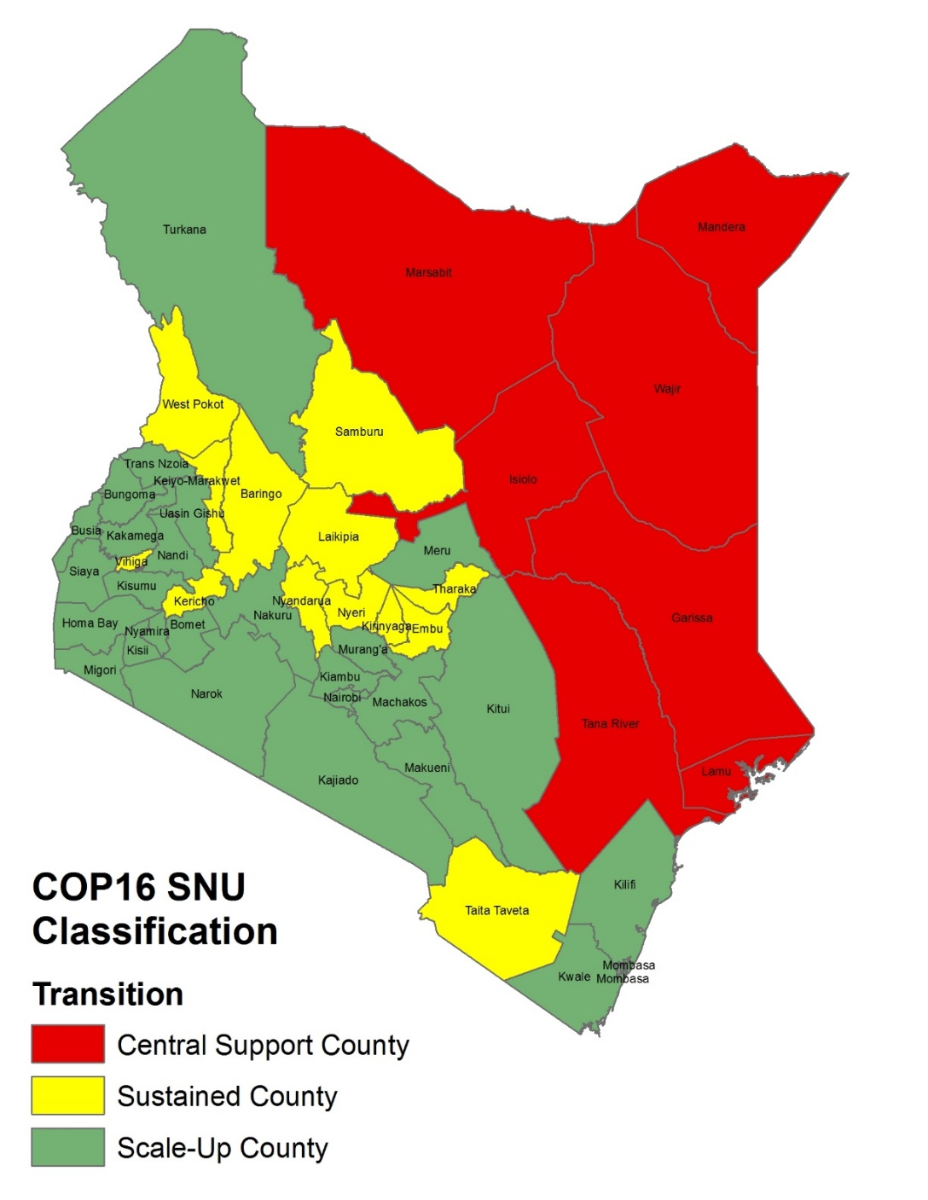
Kenya: Investment Categories by County
Transition was completed by Sept 2016
7 CS Counties: Garissa, Isiolo, Mandera, Marsabit, Tana River, Wajir, Lamu
*data included USAID sites only

Slide 5
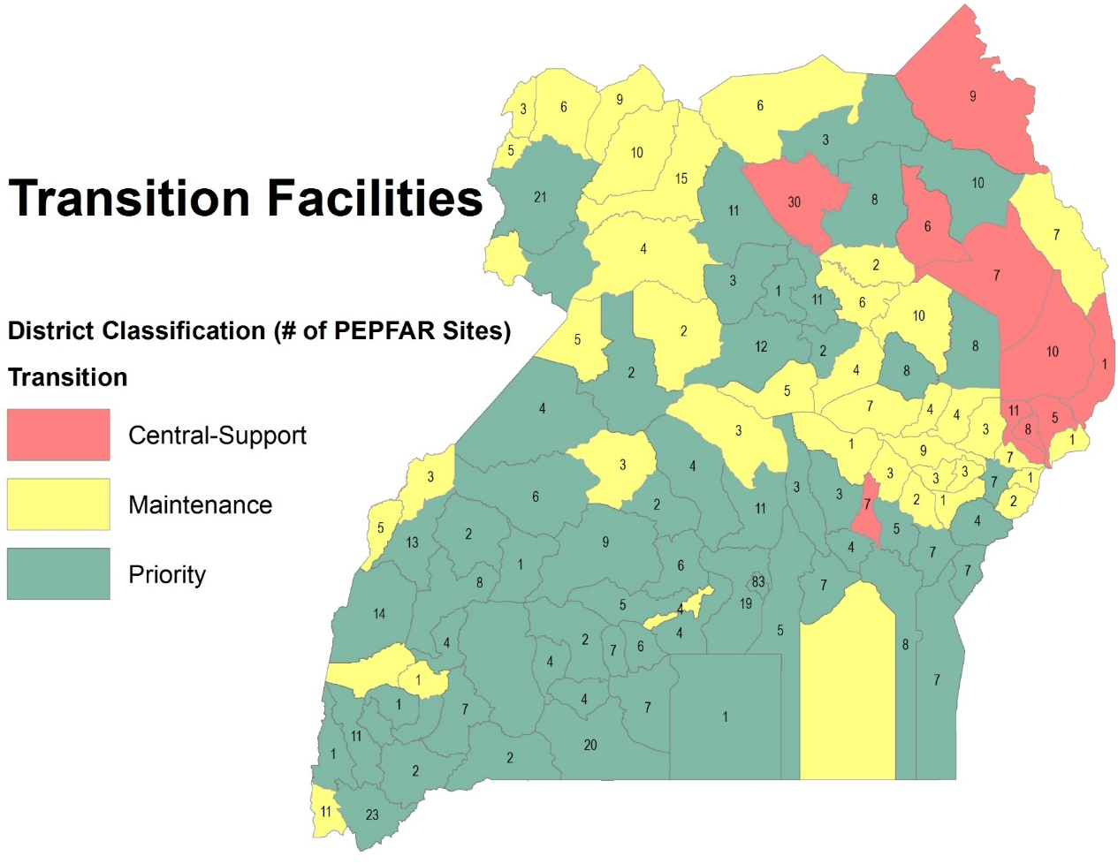
Uganda: Investment Categories by District
Transition took place between April 2015 and March 2017
10 CS districts + 700 additional facilities: Kaabong, Pader, Abim, Napak, Nakapiripirit, Amudat, Bulambuli, Kween, Kapchorwa, Luuka
*data included USAID sites only

Slide 6
Methods
Component | Sample size & target population | Data analysis
 | Cross-sectional survey: assessed health system changes and outreach components | Kenya: 230 facilities Uganda: 262 facilities | Differences between maintenance and CS facilities, and pre- and post- transition point
 | National level stakeholder interviews: explored perspectives of transition process and high level effects (2 rounds) | Kenya: 23 interviews Uganda: 37 interviews USG, MoH, civil society, IPs | Themes around transition effects; outreach or community based services data coded separately
 | Longitudinal in-depth facility case studies: explored facility level experience of transition (2 rounds) | Kenya: 5 CS + 1 maintenance facility Uganda: 4–5 CS + 1–2 maintenance facilities, depending on round | Comparisons regarding outreach across countries, between maintenance and CS facilities, and across facility levels
Notes:
While the survey highlighted some key findings on loss of outreach broadly, nuances and themes primarily emerged from qualitative data in case studies

Slide 7
Results: Overall Loss of Outreach Services in Both Kenya and Uganda
In Uganda, CS facilities significantly more likely to lose outreach support than maintenance
In Kenya, similar rates of reported loss across both CS and maintenance sites
Proportion of facilities discontinuing outreach since transition (unadjusted comparison)
 | Central support | Maintenance
Kenya | 39% | 36%
Uganda | 52% | 4%
Notes:
The decline in outreach likely reflects, in part, a broader PEPFAR shift to facility-based services, targeted testing and outreach.

Slide 8
Results: 1st 90—Knowing status
Respondents in both countries expressed concern about lost support for community-based outreach for HIV testing, resulting in fewer new clients being identified. Respondents from 5 out of 7 case studies in Uganda and 5 out of 6 in Kenya highlighted this; respondents were primarily facility in-charges followed by patients themselves
In Uganda less outreach in particular to key populations—e.g., sex workers, boda-boda riders, fisherfolk
“ …we also used to go to particularly bodaboda people, we also used to go the fishermen people, but now you can’t go there, who would pay for transport, who would pay for your lunch, who are you to come, where do you get the advertisement, so really it has affected.”
—Uganda, Expert Patient, Central Support Facility (R1)
In Kenya, some respondents specifically discussed the challenge of stigma as a barrier to testing
“This is a community where stigma is very high. So, convincing somebody to undergo HIV test[ing] here, it is not an easy thing. If you do not conduct outreach, the number of clients who are going to come to seek these services is very low. So, coverage has gone down.”
—Kenya, County Health Office, Central Support County (R1)

Slide 9
Results: 2nd 90—Receiving ART
Common concern expressed across both countries is that of patients defaulting from treatment. In Uganda, this concern was seen in 5/7 case studies primarily in Round 2, while in Kenya this emerged in 5/6 case studies equally across both rounds
Patients in particular discussed this issue at length
Loss of informal support workers who help clients receive treatment and trace clients in the community when they default
Uganda: transition facilities terminated 9% of the HIV workforce, 52% of which were peer educators, mentor mothers, or volunteers
“Patient #2: We have lost many patients.
Patient #6: Because before we used to go and visit them. They even used to give us airtime. We could call them and we could know how they were doing. If they had missed an appointment, why they had not come…”
--Uganda, Expert Clients, Central Support District (R2)
Across both countries, challenges in engaging mothers and their children without mentor mothers to enroll children in treatment were described
“…the [implementing partner] used to follow up the mothers at home, in case the child turns positive, to bring the child for enrollment. But now nobody is there to look for those mothers when their children turn positive, so they end up missing.”
—Kenya, Facility respondent, Central Support County (R1)

Slide 10
Results: 3rd 90—Viral suppression
Key concern in both countries → Patients defaulting on treatment and subsequently failing to achieve and maintain viral suppression.
Limited reference specific to viral suppression, with only Ugandan respondents discussing this
Described in 3/7 case studies by facility staff
“…to follow up these people, give them adherence counselling and testing and somehow they were adhering very well and there are various who are being suppressed and their immune systems were being boosted well. Now that connection is not there, definitely there’s a tendency that they will not adhere very well and therefore their viral load will sit higher and I think that explains why their suppression rates are low because of the exit of some of those services.”
—Uganda, Facility respondent, Maintenance District (R2)
Notes:
We had fewer data on this 3rd 90 compared to the other two. Noone in Kenya spoke directly about viral suppression, but overall these early findings are worth highlighting as changes in viral suppression take time to emerge and might be something worth monitoring and doing more research on.

Slide 11
Limitations
Outreach was not the focus of the study but it was a strongly emerging theme from the available data in both countries
Other ongoing events at the national level taking place: challenging to isolate effects of the GP process
Kenya: two health worker strikes (doctors and nurses) during the study period
Uganda: Geographic Rationalization Process (transition districts between CDC and USAID) took place simultaneously—confusing for respondents
Findings to date are mostly qualitative
Notes:
More research needed to isolate the effect of loss of outreach on the 90-90-90 targets

Slide 12
Conclusion
Loss of PEPFAR support for outreach without government replacement may be hindering efforts across the treatment cascade in CS areas in both countries.
Despite (relatively) low prevalence and burden of HIV in CS areas, decreased outreach may compound local contextual factors such as poor infrastructure and high stigma that limit access to care
Without filling the gaps in support for outreach, key links between facilities and communities could be lost, potentially compromising the country’s ability to reach and maintain the 90-90-90 goals in the long-term
Anecdotal concerns across both countries on how loss of donor support will result in limited monitoring of HIV prevalence in affected regions
A more targeted research study focused on assessing the effects of the loss of outreach would be timely.
Notes:
Concerns raised in each country:
In Kenya, specific concerns around changing migration patterns due new infrastructure being built
In Uganda, concerns around the data that was used to classify sites → maybe something Henry to mention during presentation but not put down on paper

